Slide 1

6c5b7b, c06c84, f67280, 355c7d, f8b195
C06c84
asdfa

Slide 2
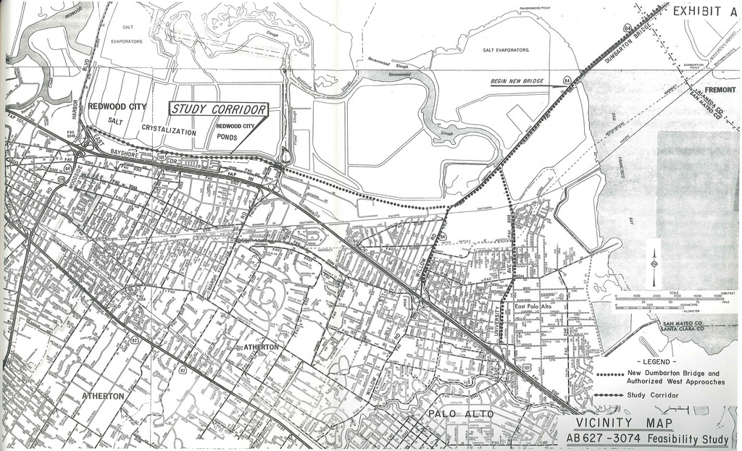


Slide 3
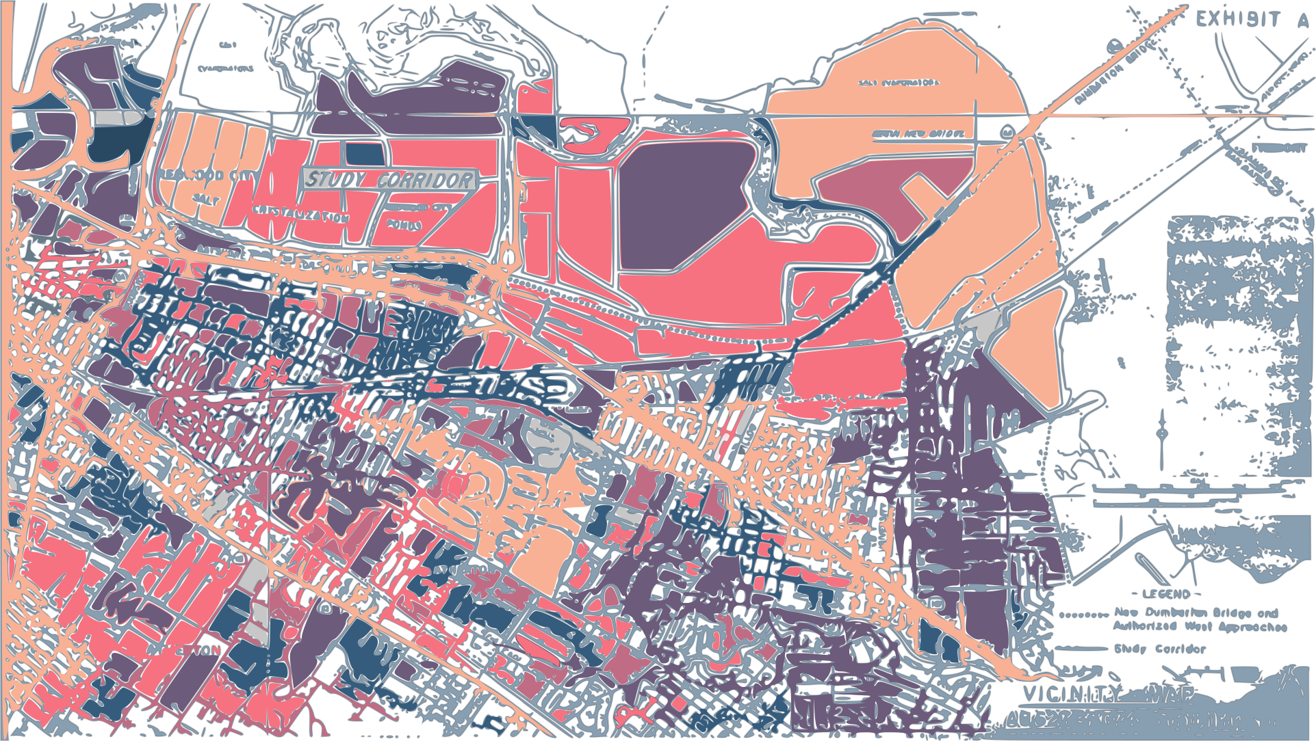

Slide 4
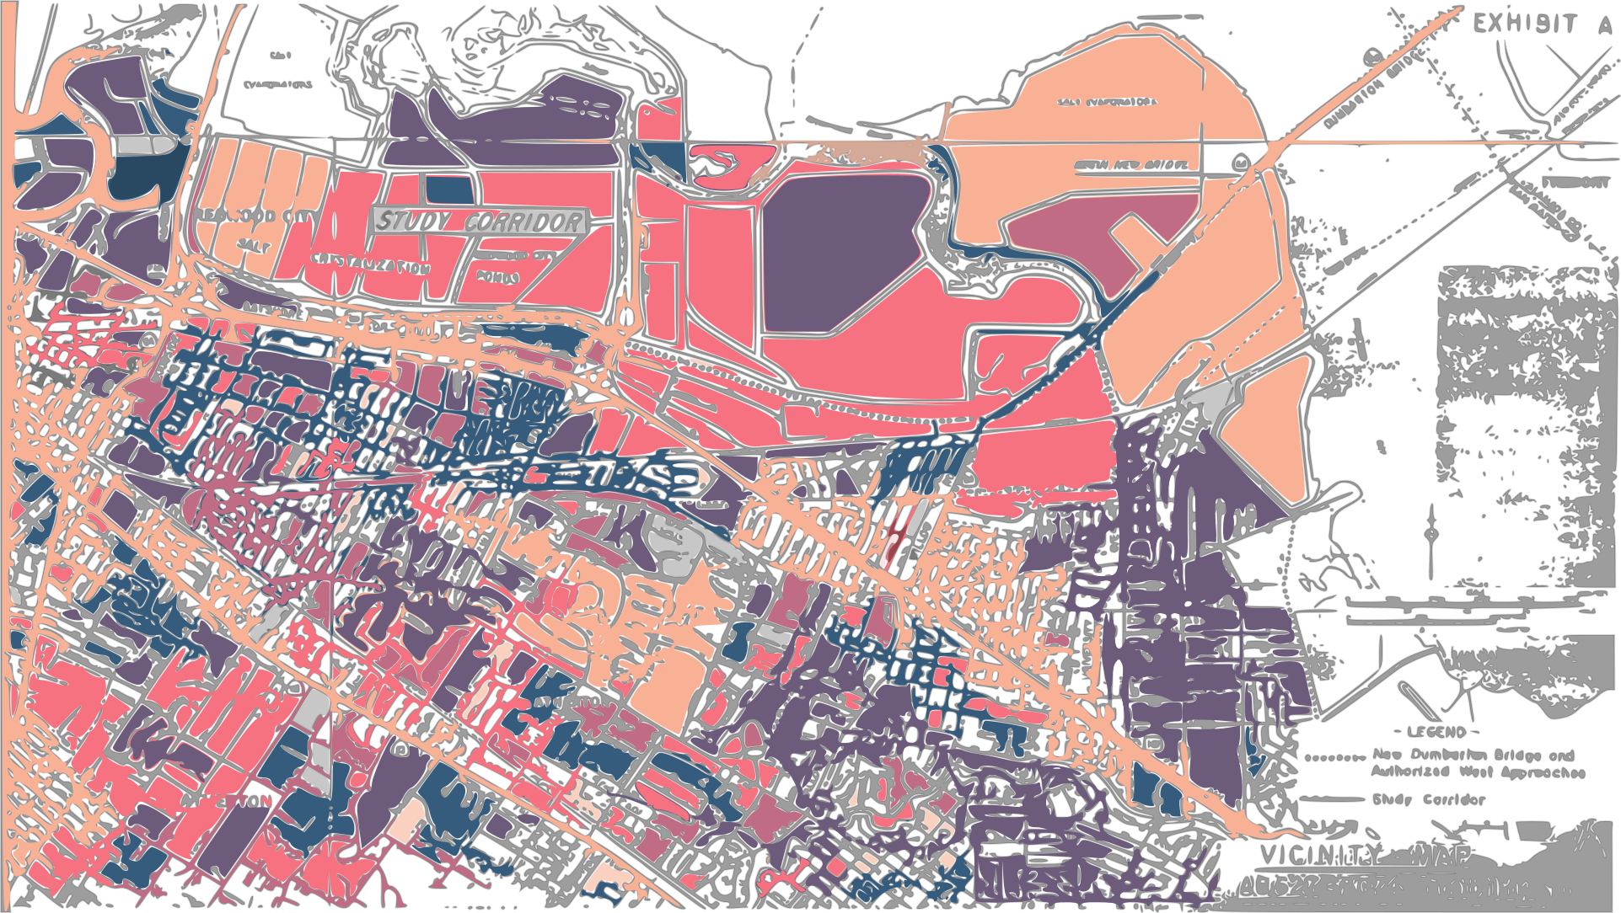

Slide 5
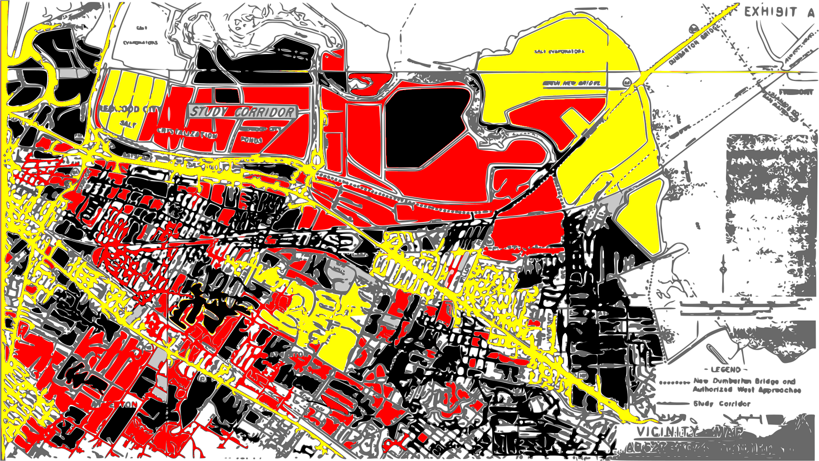

Slide 6
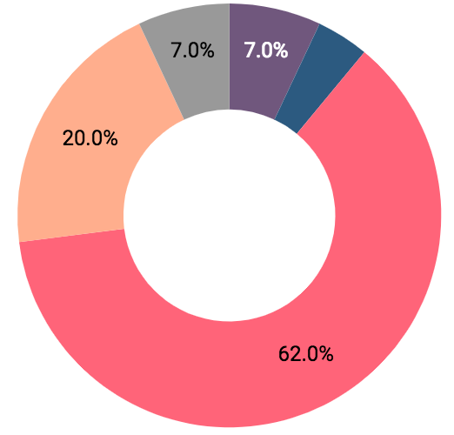
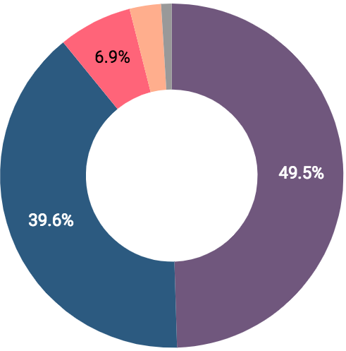
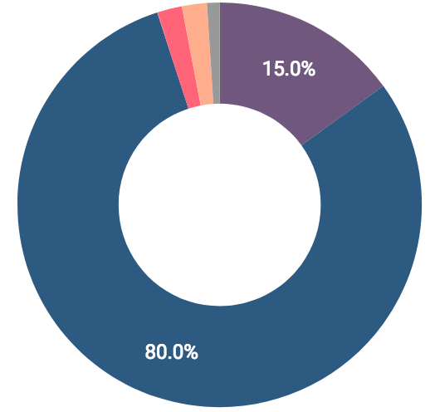
Other
Asian
Black
Black/Other
White
Latinx
Black
Latinx
White
Asian
Other
Asian
White

